Slide 1
CSC 112: Computer Operating Systems Lecture XX I/O
Department of Computer Science,
Hofstra University
Acknowledgement: Lecture slides based on UC Berkeley CS 162: Operating Systems and System Programming

Slide 2
Outlines
I/O devices
I/O hardware
I/O communication protocol
I/O communication methods
Hard Disk Drives (HDDs)
Solid-state Disks (SSDs)

Slide 3
I/O Devices
I/O and computing are two components of a computer
I/O is an important part of computing systems
I/O devices
HW can easily let us plug in diverse devices
OS can efficiently manage and interact with different devices
Two trends:
Standardization of software and hardware interfaces
New types of I/O devices
Diversity of I/O devices
Storage: Disks, SSDs
Transmission: Network connections, Bluetooth
Human computer interface: Screen, keyboard, mouse, mic, speaker
Notes:
Three‑axis gyro. Gyroscope sensor
Accelerometer.
Proximity sensor.
Ambient light sensor

Slide 4
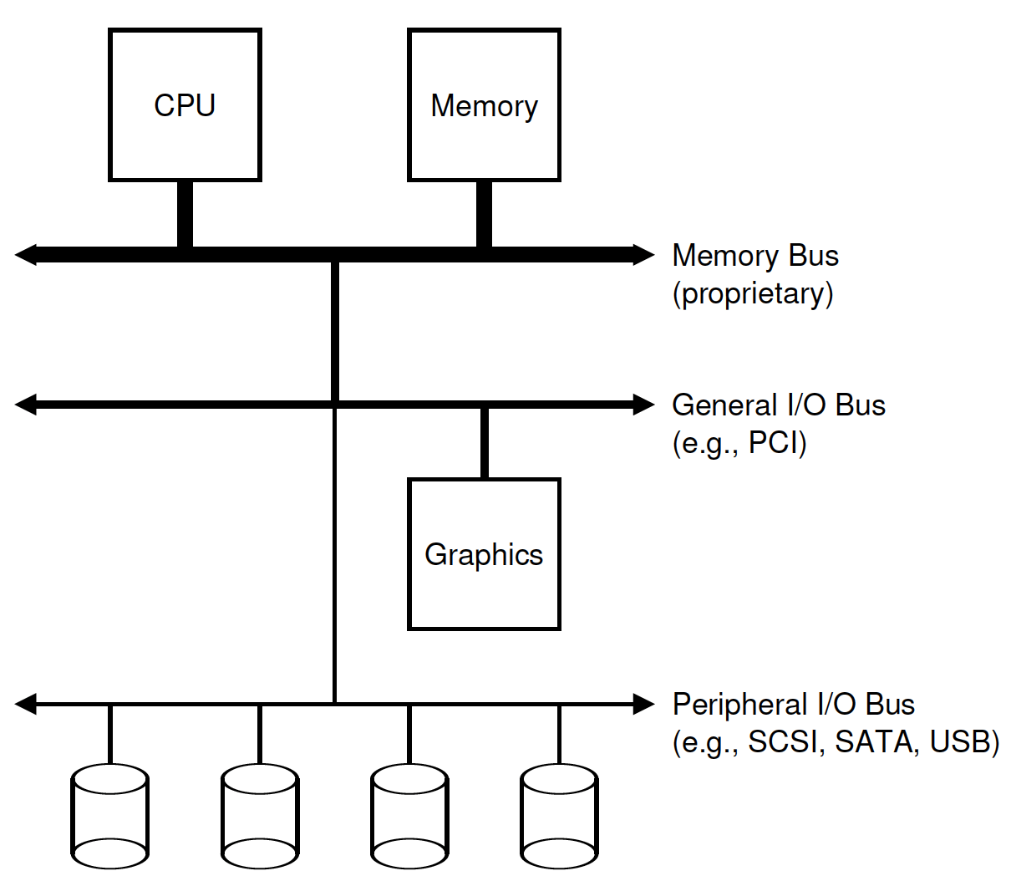
I/O Hardware
A hierarchical structure
Memory bus:
60GB/sec
PCI bus:
8-10GB/sec
Peripheral I/O bus
100-500MB/sec

Slide 5
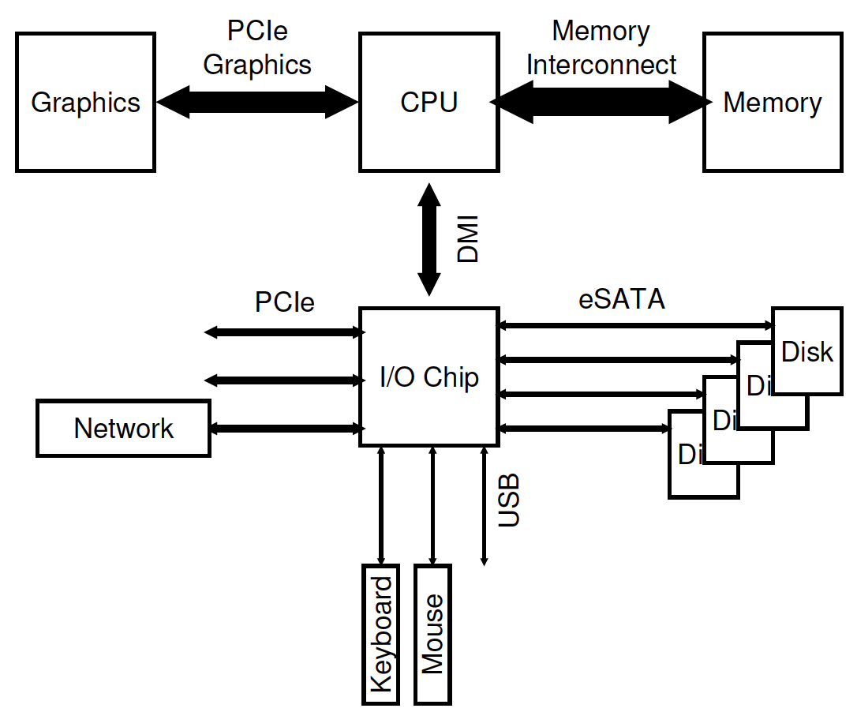
I/O Hardware in a Typical PC
Notes:
Direct Media Interface proprietary DMI 4.0

Slide 6
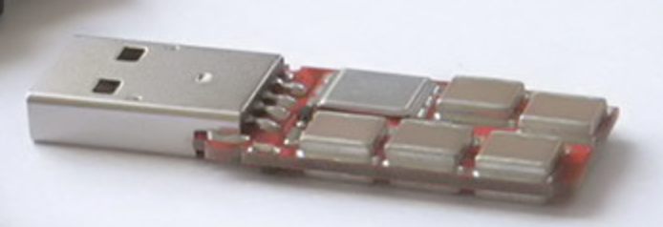
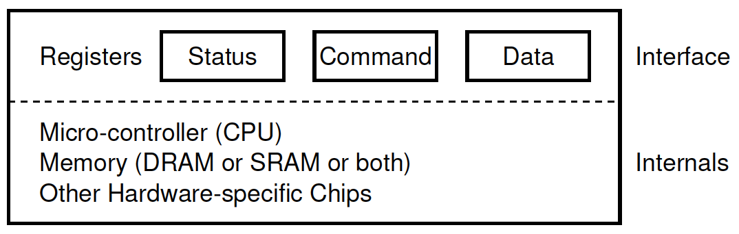
I/O Hardware
Port: Connection point for devices,
USB, HDMI, DP
Bus: Shared direct access
PCIe, expansion bus, SATA
Controller: electronics that operate port, bus, device
Contains processor, microcode, private memory, bus controller
Device driver:
Present uniform device-access interface to I/O subsystem
OS
Write
Read
Notes:
Peripheral Component Interconnect

Slide 7


I/O Communication Protocol
CPU:
A
SPIN for A
A
B
A
Polling
(Busy-waiting)
DISK:
Busy
Request
& Sleep
CPU:
A
B
A
B
A
Interrupt
(Sleep while waiting)
DISK:
Context
Switch
Interrupt
Busy
Interrupts allow for overlap of computation and I/O
Notes:
interrupt service routine

Slide 8
Interrupts VS. Polling
Fast device: Better to spin-wait than take interrupt overhead
Flood of interrupts arrive
Can lead to livelock (always handling interrupts)
Performance improvement
Interrupt coalescing (batch together several interrupts)
Notes:
Device time unknown? Hybrid approach (spin then use interrupts)
Better to ignore interrupts while make some progress handling them

Slide 9

Programmed I/O (PIO)
CPU:
A
DATA
B
A
DISK:
A
Programmed I/O
CPU directly tells device what the data is
Data transfer can be still costly

Slide 10
Direct Memory Access (DMA)
CPU:
A
B
A
DMA:
DATA
DISK:
A
Used to avoid PIO for large data movement
Bypasses CPU to transfer data directly between I/O device and memory
DMA controller
Notes:
A simple DMA controller is a standard component in all modern computers, from smartphones to mainframes

Slide 11
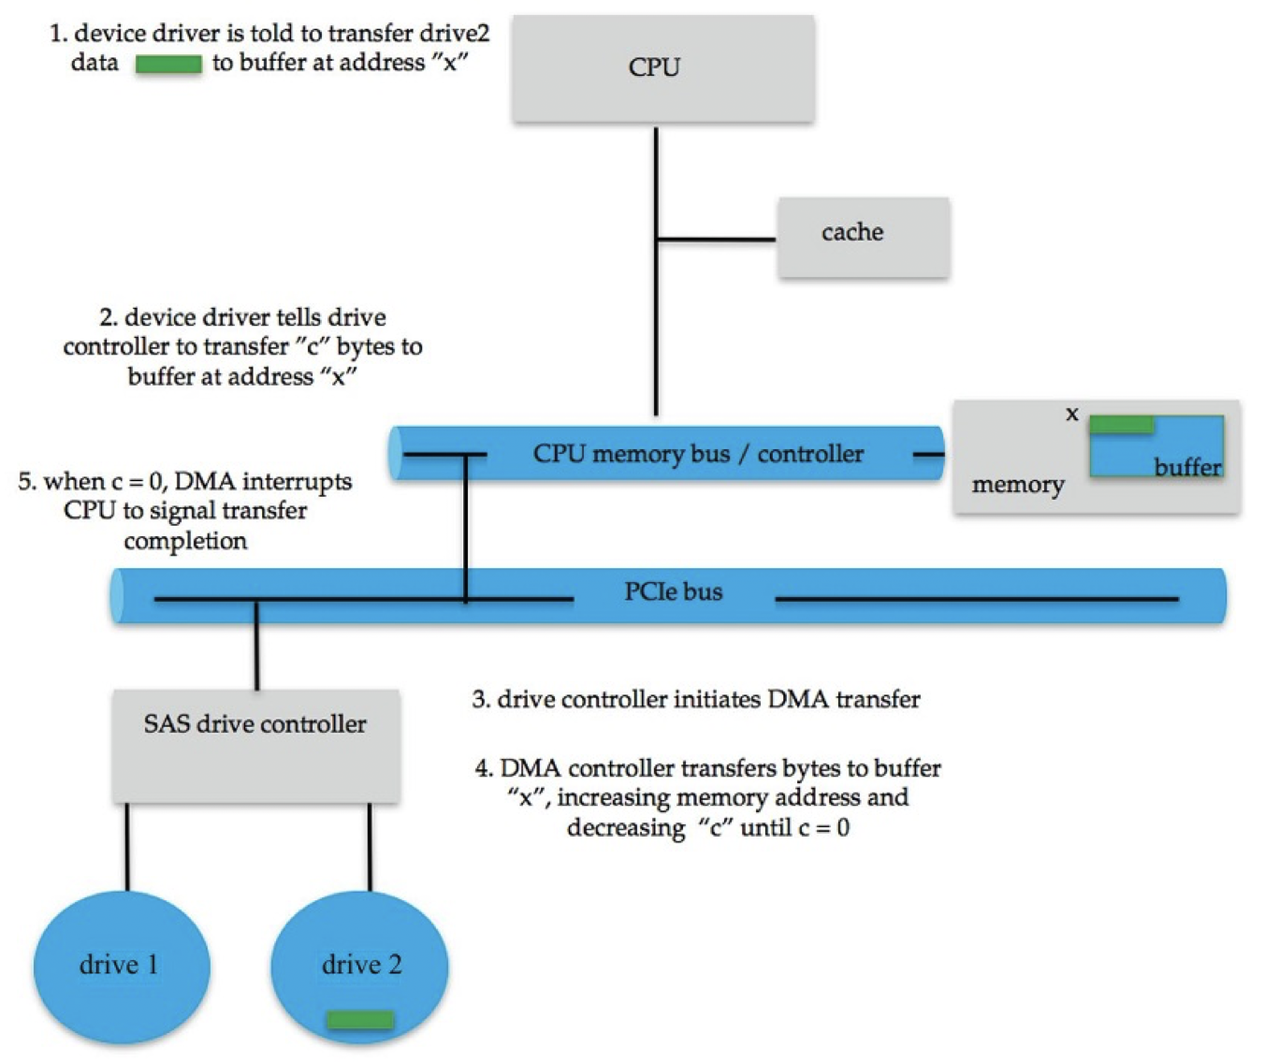
Direct Memory Access (DMA)

Slide 12
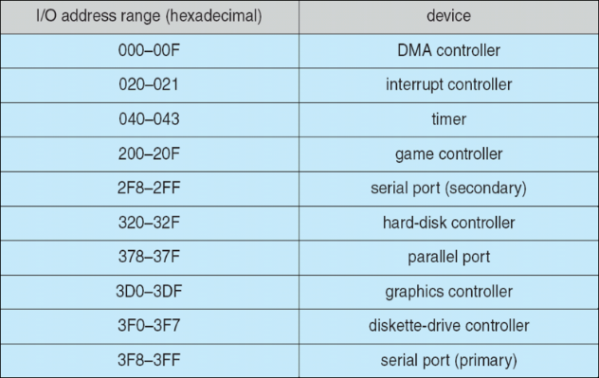
I/O Communication Methods
I/O instructions
Each device has a port
IN/OUT instructions (x86) communicate with device
IN Reg port
OUT Reg port
Memory-Mapped I/O
H/W maps registers into address space
Loads/stores sent to device

Slide 13
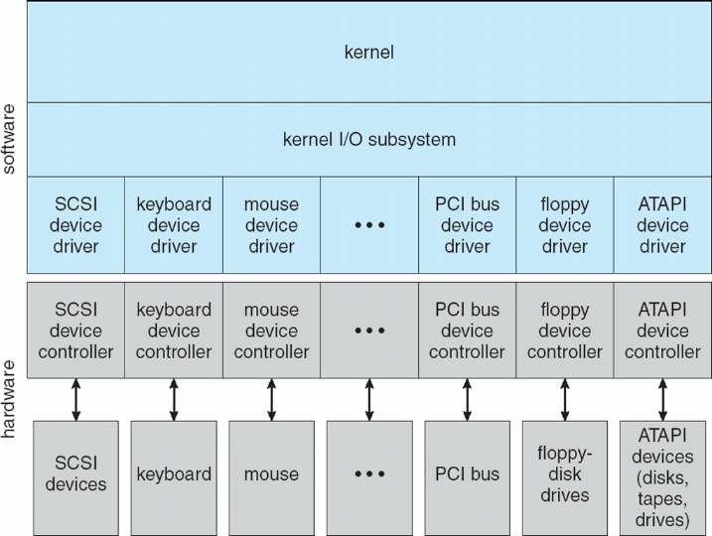
Device Drivers
Devices are diverse
Each has its own protocols
Abstraction – Device Drivers
Hide the details and differences
Provide standard interfaces
Notes:
They either design new devices to be compatible with an existing host controller interface (such as SATA), or they write device drivers to interface the new hardware to popular operating systems.

Slide 14
Hard Disk Drives (HDDs)
A magnetic disk has a sector-addressable address space
A disk as an array of sectors
Each sector (logical block) is the smallest unit of transfer
Sectors are typically 512 or 4096 bytes
Main operations
Read from sectors (blocks)
Write to sectors (blocks)

Slide 15
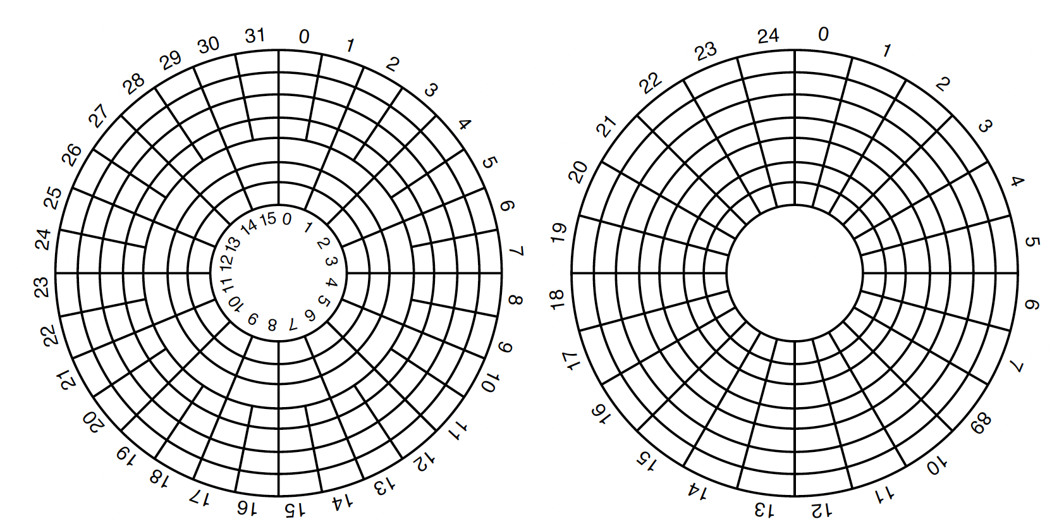
Hard Disk Drives (HDDs)
New
OLD
Outer tracks with more sectors
Inner tracks with fewer sectors
All tracks have the same number of sectors
Notes:
Figure from Modern Operating Systems 5 ED

Slide 16
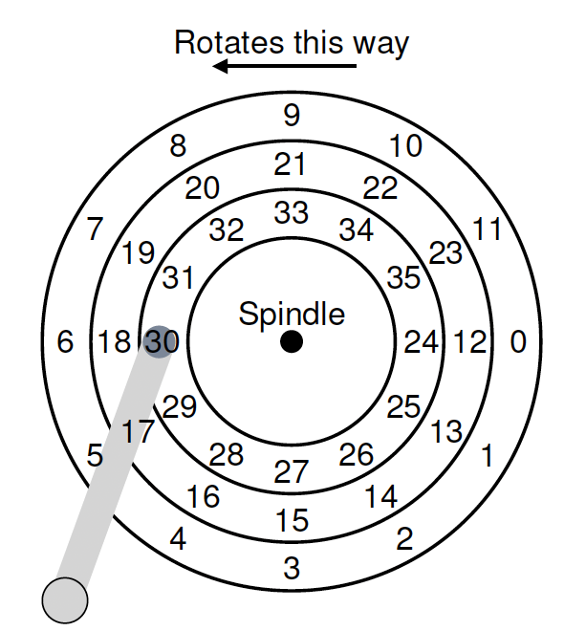
Hard Disk Drives (HDDs)
Sectors
Tracks
Platter (sides)
Arm-head
Spindle
Rate of rotation: rotations per minute (RPM)
7,200 – 15,000

Slide 17
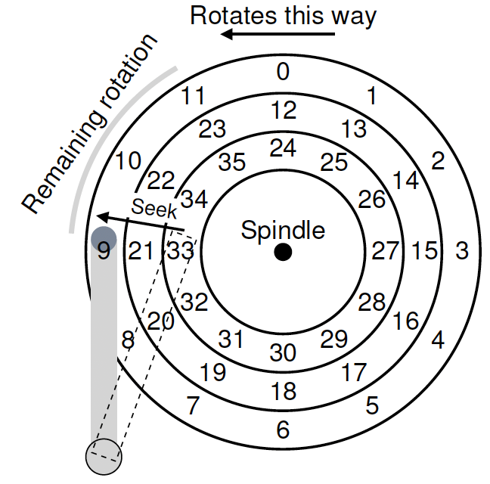
Hard Disk Drives (HDDs)
Seek for the right track
Rotate from 9 to 0
Transfer data from sector 0

Slide 18
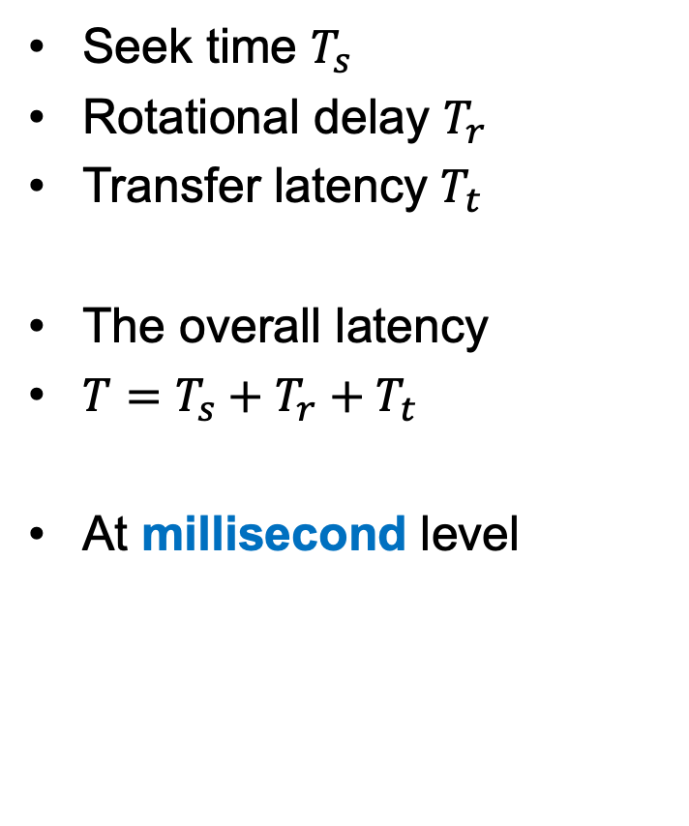
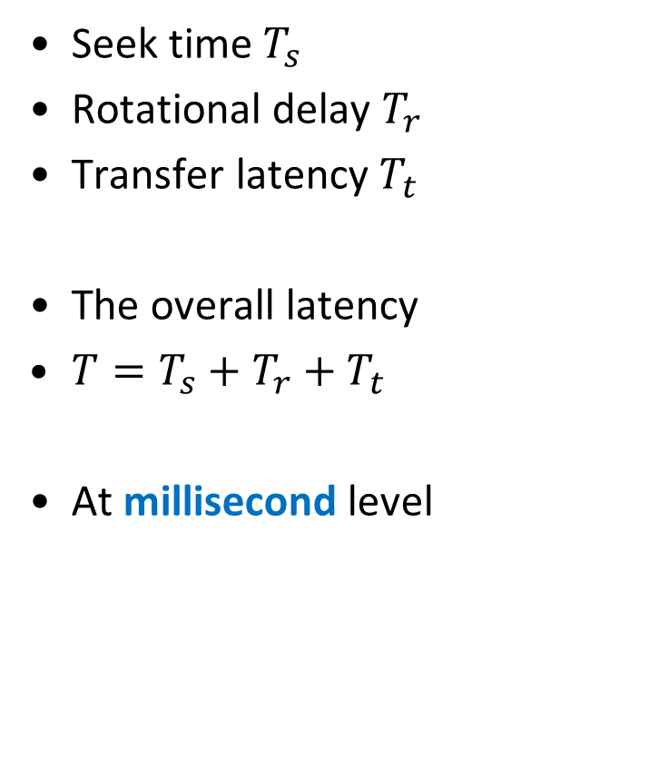
Hard Disk Drives (HDDs)
Seek time $T_{s}$
Rotational delay $T_{r}$
Transfer latency $T_{t}$
The overall latency
$T=T_{s}+T_{r}+T_{t}$
At millisecond level

Slide 19
Hard Disk Drives (HDDs)
Seek: may take several milliseconds (ms)
Function of cylinder distance
Entire seek often takes 4-10ms
Rotate: Depends on RPM
7200 RPM is common, 15000 RPM is high end
Old computers may have 5400 RPM disks
1 min / 7200 RPM = 60 sec / 7200 RPM = 8.3 ms / rotation
On average it may take 4.2 ms (*0.5)
Transfer: Depends on RPM and sector density
Pretty fast
100+ MB/s for SATA I (1.5Gb/s), up to 600MB/s for SATA III (6.0Gb/s)
512-byte sector: 1s / 100 MB = 10ms /MB = 4.9 us/sector

Slide 20
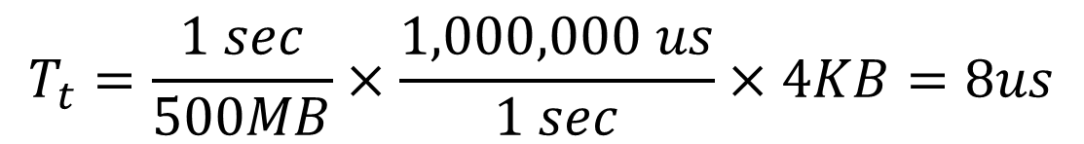
HDDs’ Performance
Metric | Perf
Avg Seek | 4ms
RPM | 7200
Max Transfer | 500MB/s
Read 4KB
$$T_{t}=\frac{1 sec}{500MB}×\frac{1,000,000 us}{1 sec}×4KB=8us$$
$$T=4ms+4.2ms+8us=8.208ms$$
Avg Seek
Avg Rotate

Slide 21
Effect of Workloads
Seeks and rotations are slow while transfer is relatively fast
What kind of workload is best suited for disks?
Sequential I/O: access sectors in order
Most of time is spent on transferring
Random workloads access sectors in a random order
Slow on disks
Seek+rotation dominate
Avoid random I/O if possible

Slide 22
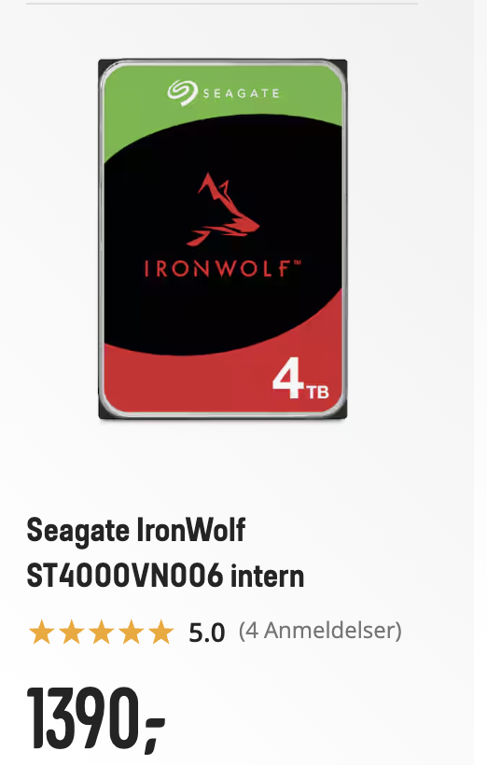
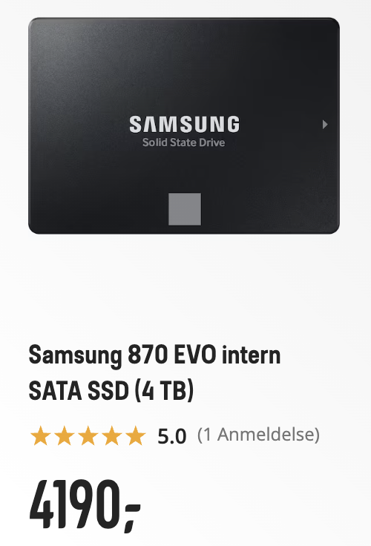
Solid-State Disk (SSD)
HDD – Mechanical Disk
Slow (seek, rotate, transfer)
Poor performance for random I/O
$ cheap
High capacity
Solid-state disk (SSD) – flash based disk
Single or multiple transistors for storage
Fast: no moving, no seek
Parallel
$$ More expensive
Wear out issue

Slide 23
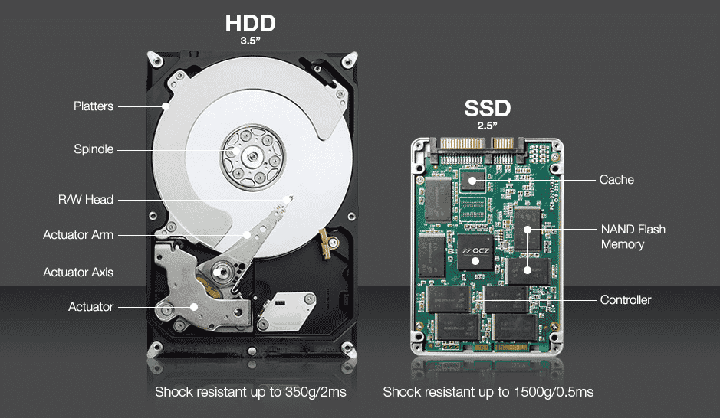
SSD
HDD – Mechanical Disk
Slow (seek, rotate, transfer)
Poor performance for random I/O
$ cheap
Solid-state disk (SSD) – flash based disk
Single or multiple transistors for storage
Fast: no moving, no seek
Parallel
$$ More expensive

Slide 24
SSD
charge
0
0
1
Single level cell (SLC)
charge
00
01
10
11
Multi-level cell (MLC)

Slide 25
SSD
 | SLC | MLC | TLC
Bit/Cell | 1 bit | 2 bit | 3 bit
Performance | High | Media | Low
Reliability | High | Media | Low
Capacity | Low | Media | High
Price | High | Media | Low
Applications | Servers, industrial applications | Consumer products | Most of consumer products
Quadruple level cell (QLC) is also available.

Slide 26
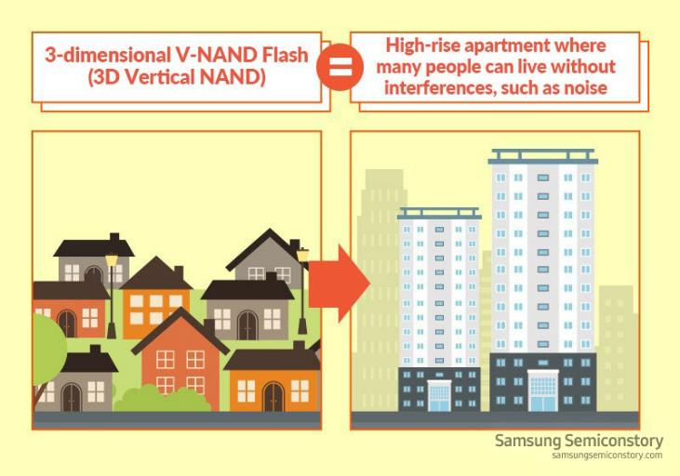
SSD

Slide 27
SSD
Bank
SSD
A NAND-flash memory is divided into banks
Banks can be accessed in parallel
Each bank consists of many blocks
Erase unit
1024– 4096 blocks for a bank
128 or 256 KB
Each block is made of pages
Read & write unit
4KB, 2-8KB
Block 0
Block 1
Block 2
Block 3
Page

Slide 28
SSD
Writing to a page is strange and costly
We cannot directly overwrite a used page
We must erase the target page before writing
Erase
Program
page 0
page 1
page 2
page 3
Block
101010
110011
111001
100111
Write 101100 to page 0

Slide 29
SSD
Writing to a page is strange and costly
We cannot directly overwrite a used page
We must erase the target page before writing
Erase
Program
page 0
page 1
page 2
page 3
Block
111111
110011
111001
100111
Write 101100 to page 0
Erase page 0

Slide 30
SSD
Writing to a page is strange and costly
We cannot directly overwrite a used page
We must erase the target page before writing
Erase
Program
page 0
page 1
page 2
page 3
Block
101100
110011
111001
100111
Write 101100 to page 0
Erase page 0
Program 101100 to page 0

Slide 31
SSD
Programming one page needs to erase the whole block
Use memory to temporarily store blocks
page 0
page 1
page 2
page 3
101010
110011
111001
100111
Block 0
Write 101100 to page 0
Erase all pages
page 0
page 1
page 2
page 3
111111
111111
111111
111111
Block 0

Slide 32
SSD
Programming one page needs to erase the whole block
page 0
page 1
page 2
page 3
Memory
101010
110011
111001
100111
Block 0
page 0
page 1
page 2
page 3
111111
111111
111111
111111
SSD
Block 0

Slide 33
SSD
Programming one page needs to erase the whole block
page 0
page 1
page 2
page 3
Memory
101100
110011
111001
100111
Program page 0
Block 0
page 0
page 1
page 2
page 3
101100
110011
111001
100111
SSD
Block 0

Slide 34
SSD
Latency of SSD
Read: 10-50us
Erase: 2ms
Program: 200-500us
Wear-out
Erasing and programming slowly accrue a little bit of extra charge.
Difficult to distinguish 0 and 1 over time.
Evenly distribute data over SSD to avoid overuse of some pages and banks
0
0
0
0
0

Slide 35
Summary
I/O Devices
Standardized interface
Interrupt vs Polling
DMA vs PIO
The structure and performance of HDDs
The structure of SSDs

